Slide 1




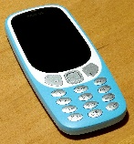
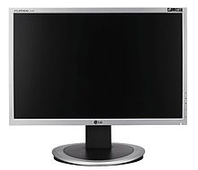
Upload picture
Analyses image(Open CV)
Script comment
Object detection
tracker
Finding and locating specific objects within an image
User
Detects Objects Automatically
Detects the objects in the image
Powerful image
analysis and
objects detection
Labelled and detected objects

